Slide 1





Presentation
BY: VON

Slide 2








HOME
about
CAMPAIGN
CONTACT
WELCOME
TO JOLLIBEE
BILI KANA SA JALIKOD
CONTINUE

Slide 3

Student Grade Encoder & Calculator
Welcome Professor
CONTINUE

Slide 4
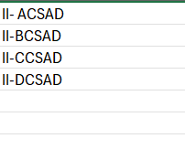
Student Grade Encoder & Calculator
SELECT

Slide 5
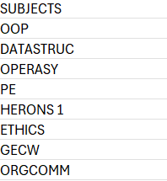
Student Grade Encoder & Calculator
SELECT
VIEW GWA

Slide 6
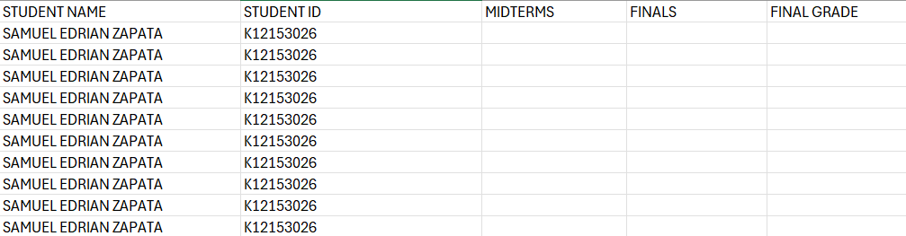
Student Grade Encoder & Calculator
EDIT GRADE

Slide 7
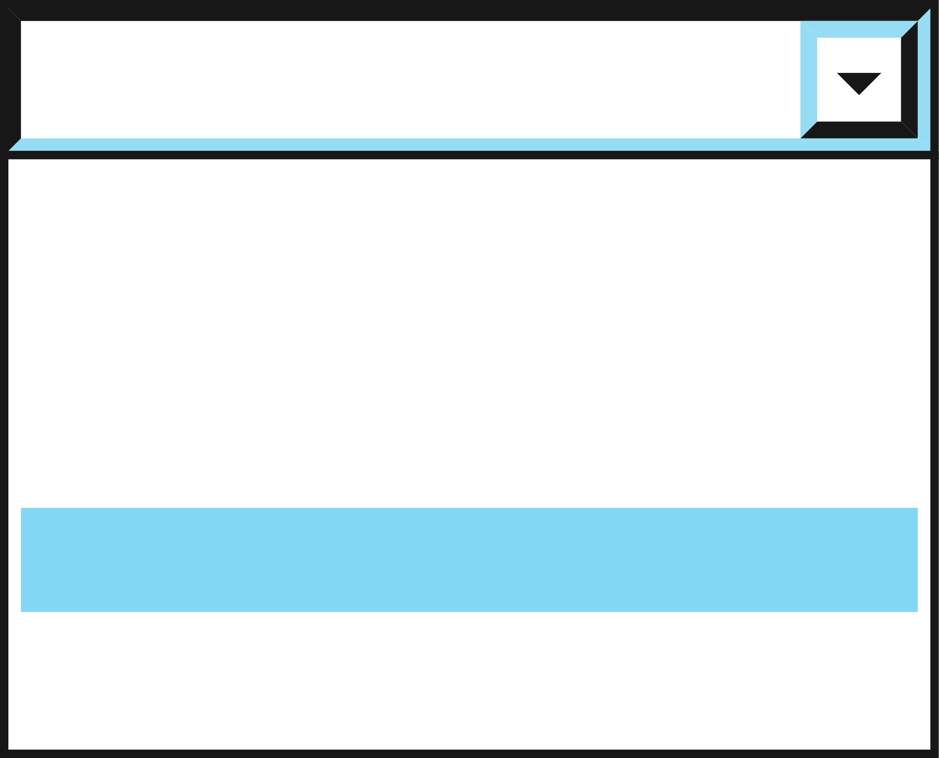
Student Grade Encoder & Calculator
Samuel Edrian T. Zapata
K12153026
MIDTERMS
FINALS
RECITATION
ACTIVITY
QUIZ
EXAM
COMPUTE GRADE

Slide 8


Thank You

